Slide 1
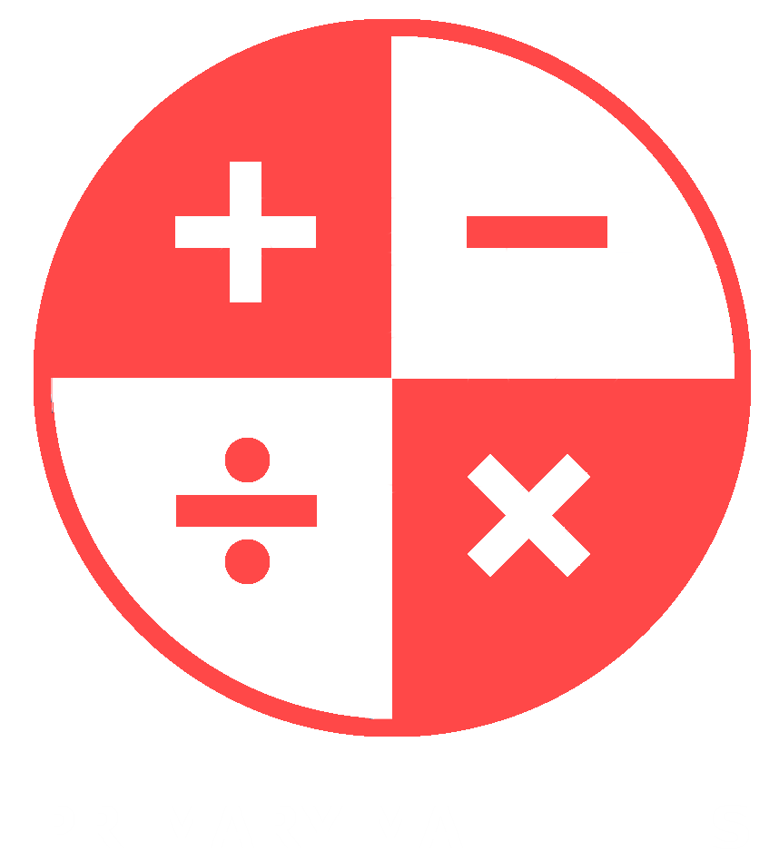

Primary Mathletes – Primary School Mathematics Teaching Aid Application
Paul Davis
C16324311
DT282/4
Computer Science International
Supervisor: Cindy Liu

Slide 2
Project Overview
An application that aims to aid teachers and students in the retention and enjoyment of learning primary school maths.

Slide 3
Content
Introduction
Background Research
Design
Development
Testing and Evaluation
Conclusions

Slide 4
Introduction
Something sexy quote ? What makes the app necessary

Slide 5
Background
Systems that inspired the design. Pictures of other apps. Compare end app verbally saying you liked one apps looks, anothers design anothers features / function etc.

Slide 6
Background
List of all the references to background research in the dissertation

Slide 7
Methodology
Explain why it was chosen show image of trello/airtable and say why it was useful

Slide 8
Design
System architecture diagram explain how its 3 tier

Slide 9
Front-End Design
Show off front end design 2-6 slides, highlight the evolution of the design as well as key aspects of the front end

Slide 10
Back-End Design
Same as last slide but for back end, show evolution

Slide 11
Development – Technologies Used
Maybe lob in all of the icons for each thing
Windows 10, linux ,macOS ,programming lang: python
scripting lang: javascript, database: firebase db, other technologies: pycharm IDEm github, airtable, trekkim gunom audacity, buildozer, xcode, gmail, jsfiddle, pythonfiddle, ms office, draw.io, staruml, wireframe.cc, python idle, social media, ms paint, Zotero, google form, zoom, metachart.com

Slide 12
Development
Technical Architecture Diagram

Slide 13
Development
Talk about challenges, include code snippetsm talk about places you got solutions, youtube, stack overflow, 6-10 slides.
Learning how to use kivy with limited resources, timinf was an issue towards the end but all key features were implemented, creating a good random answer function, achieved by making a version in JS first

Slide 14
DEMO
Show demo video

Slide 15
Testing
1-5 slides, mention types of testing done, questionnaires, allowed users to work through app unassisted with a list of tasks to complete.

Slide 16
Evaluation
Results of questionnaires/ testing talk about places where there were optimizations to be made IN DISSERTATION ALREADY

Slide 17
Conclusions
3 conclusions from the project.

Slide 18
Future Work
3 interesting things to be done in the future
Maybe more input from students and teachers – finally set up a testing group for better feedback and redevelopment

Slide 19
Thank you + Q and A

